Slide 1
Gestión del Desarrollo Sustentable
Plataforma de Inteligencia Analítica

Slide 2
Agenda
1
La oportunidad, el reto
2
La solución
3
Beneficios para el negocio
4
Casos de éxito

Slide 3
1
La oportunidad, el reto
Notes:
3

Slide 4


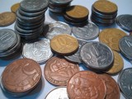
Definición
“Asegurar que los recursos de hoy que estamos utilizando no pondrán en riesgo los recursos del mañana”
Hau Lee (Profesor de Operaciones, Stanford University)
Tres Aspectos Primarios de la Sustentabilidad
Medio Ambiente
Social
Económico
Notes:
4
Sustainability is all about clever usage of resources
Understand that if you use them too much today, you will not have them available tomorrow
Every newspaper, every TV channel talks about green, climate change, global warming.
All this topics come to sustainability, but sustainability is not only about environment, it’s also about social responsibility and economic balance.
It's by managing correctly this three aspects that you will achieve a true sustainable business.
For example, if you sell a product that comes from a non-renewable source, sooner or later, your customers will stop buying from you and your business model will be in danger, so it’s time to start thinking on alternative business model that can guarantee a sustainable business model.
Just to clarify green-eco-earth-environmental-friendly semantics: sustainability incorporates three primary aspects of organizations:
Environmental, Social, and Economic.
We’re talking about governmental or business entities that have a capacity to effect their environment, their people, or their economy… that is, every organized institution. This is also known as the triple-bottom-line, planet, people, and profits.
Environmental is typically the most ubiquitous given all the attention around climate change, water quality, etc., with social a close second, dealing with things like child labor, employee rights, and safety. Economic is how we have historically measured a company; if they can’t stay in business, they’re hardly sustainable. It’s important to recognize that with certain compliance initiatives such as Sarbanes Oxley, companies may be under greater to pressure to disclose “risks” associated with sustainability. For example, if you sell a product that comes from a non-renewable source, how long will you be able to sustain that business model, and how soon before your customers stop buying those non-renewable products from you because of changes to their own business model.

Slide 5
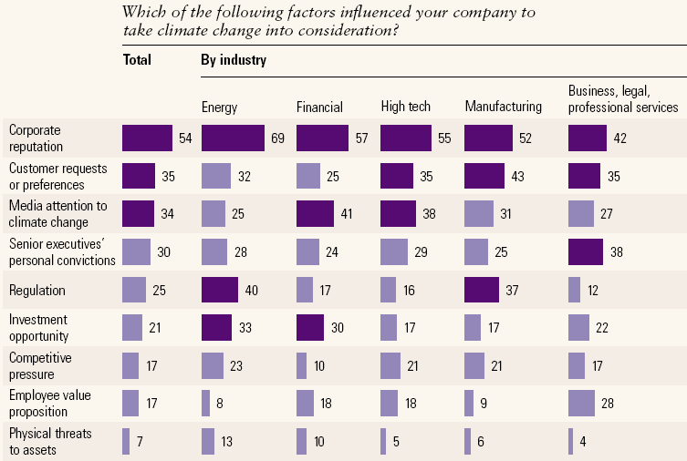
Principales Factores de Influencia de la Sustentabilidad en la Industria Energética
How Companies Think About Climate Change; McKinsey 2008
Notes:
This is a recent global study by McKinsey that highlights the various drivers of sustainability for different industries.
For Energy, we see the most significant factors influencing their sustainability programs are:
Corporate Reputation
Regulation
Investment Opportunity

Slide 6
Retos de la Gestión de la Sustentaibilidad
¿Nuestras declaraciones de emisiones reflejan la realidad?
-La sociedad demanda mayor información sobre emisiones a las corporaciones y estas requieren una mayor eficiencia en las capacidades para generar dicha información de manera confiable –
¿Si tengo que invertir para cambiar un proveedor/proceso/producto, que valor tiene en términos de emisiones?
- Las decisiones ambientales normalmente requieren de un cambio importante en la administración de las empresas y organizaciones -
¿Cómo integro la información de emisiones de mis proveedores y distribuidores a mis procesos?
- La visibilidad a través de la cadena de valor es incipiente -
Sabemos cuanto gastamos en electricidad ¿pero lo conocemos en términos de Kilowatt/hora?
- La información de los reportes sociales y ambientales no está agregada ni integrada a lo largo de la organización –
Notes:
While the push towards sustainability is strongly adopted in management theory, it is difficult to implement in practice. Why?
Evaluating tradeoffs: If I have to make a capital investment to change a provider/process/product, what is it worth to me in terms of # and emissions?
The data is often spread out in the operating units.
The data might not exist today in traditional systems (you might capture how much $ you spent on utilities, but do you know the kilowatt hours?)
Stakeholders (regulators, shareholders, community groups, governments) are asking for more and more information. A robust and flexible reporting environment is required to satisfy these demands.
Your suppliers & distributors (value chain) do contribute materials and emissions to your processes. This is a “scope 3” emission, but it can be significant. How do you capture that data?

Slide 7




Sustentabilidad:
Una Tendencia Global de Educación
Global, regional, y guías de industria
Estándares más relevantes:
  International Petroleum Industry Environmental Conservation Association (IPIECA)
  Global Reporting Initiative G3 Guidelines (GRI G3)
  International Standards Organization ISO14000
  Greenhouse Gas Protocol
    Utilizado por el Carbon Disclosure Project y US EPA
Notes:
Governments, Non-Profits, and Industry Associations are providing management guidance on elements of sustainability performance and accounting for carbon emissions.
[AE – Ask the prospect if they are familiar with these organizations. SAS has adopted the GRI for performance reporting and the GHG Protocol for calculating carbon footprint]
We can also support the voluntary reporting requirements outlined by IPIECA – International Petroleum Industry Environmental Conservation Association http://www.ipieca.org/
Most of these organizations focus on environmental AND social excellence.

Slide 8
Una Organización Sustentable
Reportes
Reportes Departamentales
Mecanismos de Colección de Datos basados en Excel
Definiciones Rudimentarias de Métricas
Métricas no bien entendidas
No automatización en la publicación de métricas
Validación
Captura de información “madura” Información ganan credibilidad
Información exacta, sirve como marco para desarrollar la estrategia departamental
Fortalecer “experiencia”
Comunicación
Cultura consciente del Carbón
Estrategias y objetivos empresariales, abarcando múltiples departamentos
Atraer capital y talento
Adoptar normas en toda la organización
Colaboración
Trabajar con terceros para cambiar procesos
Evaluar el impacto de ciclos de vida y del comportamiento del cliente
Adaptarse a los cambios en un mercado global de carbono
Convergencia
“Green” es el negocio
Centrado en el crecimiento rentable de los productos y ofertas de servicios
Liderazgo del mercado
Innovar
Optimizar
Integrar
Consolidar
Operar
Departamento
Organización
Notes:
Where is your organization on this maturity curve?
The five levels – Operate, Consolidate, Integrate, Optimize, and Innovate are all milestones in a company’s progress toward continuous “green” innovation.
Level 1 – Operate: Report on lagging environmental indicators, not tied to corporate strategy
Generally, one person <called “information maverick”> can get to information. They may be tracking environmental performance measures, but information standards are fairly non-existent. Quality and consistency is very questionable – a lot of gut feel decisions occur. Most decisions are made here through raw instinct. They are unable to recognize opportunities and or risks associated with corporate sustainability.
Level 2 – Consolidate:
Here, in the consolidate level, the company has progressed to departmental or functional focal points, often to quantify and validate impacts such as greenhouse gas emissions. Capture and report on data in silos without an enterprise strategy. Data are all locally stored and analyzed by individuals with experience in that subject area.
Level 3 – Integrate:
Silos of information are integrated into an enterprise view of the company. Calculate, model and most importantly defend their strategies and calculations for sustainability. They are establishing “green credibility”. This is critical to attract capital investments and new talent. For the first time, managers can actually see across functions, and understand how the company performs as a whole entity. It is a new level of “carbon consciousness” that permeates the culture – both in the workplace and in the world.
Level 4 – Optimize / Collaborate
The company will quickly focus on market alignment to emerging standards and then – once aligned – will work toward incremental improvements. This means increasing or driving revenue by quickly adapting to market changes – and then incrementally removing cost AND carbon from the process wherever possible.
Level 5 – Innovate
Green IS your business; Convergence. When this happens, the intelligent enterprise will look to expand to new markets, new products, and new business models to create advantages over their competitors.

Slide 9
2
La solución
Notes:
9

Slide 10
Construyendo una visión para el Desarrollo Sustentable
Organizacional Cultura, Innovación y Responsabilidad
Información Significativa
Hacer lo mejor, no la decisión más fácil
Los recursos son liberados para el análisis de valor agregado
Una versión de la verdad a través de todos los sistemas
Sustentabilidad es parte del día a día.
Crecer en una organización que opera como una gran compañía
Información correcta, para hacer decisiones correctas en el tiempo correcto
Información oportuna permite toma de decisiones proactiva (no reactiva)
Extinción de incendios es la excepción y no la regla.
Aprender de los errores
Criterios de medidas de desempeño son transparentes y confiables
Automatización
Alineación alrededor de las principales métricas atadas al desempeño
Claridad alrededor de las relaciones causales y las opciones de mitigación

Slide 11
¿Cómo llegar?
Innovación Social
Eco-Vision
Adquisición de Talento y Retención
Planeación Estratégica
Conformidad
Liderazgo Económico
Business Analytics
Herramientas de Evaluación
Crecimiento
Ventaja Competitiva
Optimización
Modelado de Huella de Carbono
Implementa, Monitorea, Mejora
Rentabilidad
Análisis Causa Ráiz
Administración Organizacional del Riesgo
Desempeño Predictivo
Optimización de TI
Análisis Escenarios
Monitoreo de Procesos de Negocio
Medicón del Impacto de la Cadena de Valor
Notes:
We’ve covered the drivers, the challenges, and some emerging guidance. So how do you make this actionable in your company?
[This is a building slide]
It starts with an “Eco Vision” or other leadership adoption of goals.
[click]
That vision permeates your Strategic Planning. And as we’ve mentioned, sustainability has close ties to social innovation and economic leadership. Sustainability should be aligned with the organization’s goals for talent, growth, and profitability.
[click]
In order to facilitate decision-making (which projects to invest in), an organization needs business analytics. What is my footprint today? What is driving our emissions? Where will it go in the future? What if I change this process?
[click]
By focusing on the initiatives that have the most ability to drive execution towards your sustainability goals, it can lead to a competitive advantage.
[click]
But this advantage doesn’t last forever. It is important to continuously monitor and improve performance on key sustainability indicators. Drive innovation and mitigate risk.

Slide 12
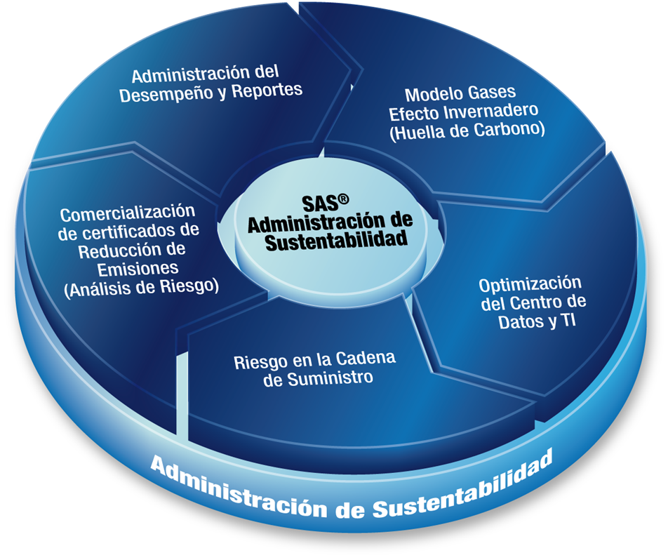
SAS® Gestión del Desarrollo Sustentable

Slide 13

Características Principales
Modelar la huella de carbono actual y futura
Elaborar Informes de Responsabilidad Social con medidas de desempeño con consistencia y transparencia, de acuerdo a Global Reporting Initiative (GRI)
Dirigir análisis de escenarios What-if para evaluar programas alternativos, costos y beneficios
Pronosticar el desempeño de indicadores clave (económicos, sociales y ambientales)
Integrar análisis de riesgo para operar eficientemente en los mercados de comercialización de Certificados de Reducción de Emisión de Bonos (Cap & Trade)
Notes:
Why would a customer care about applying technology to sustainability? What can SAS enable that an excel spreadsheet cannot?

Slide 14

Características Principales
Determinar los principales indicadores de emisiones de carbono, consumo o gasto de agua
Modelar como los proyectos alternativos destinados a reducir aquellos indicadores tienen un efecto cuantificable en el logro de las metas.
Cuantificar el impacto de las condiciones del mercado, tales como costos de gasolina o el aumento de la demanda de almacenamiento, tendrán en el consumo y en las emisiones.
Predecir cómo el límite de carbono (cap carbón) puede afectar financieramente a la organización si las acciones no son tomadas hoy

Slide 15
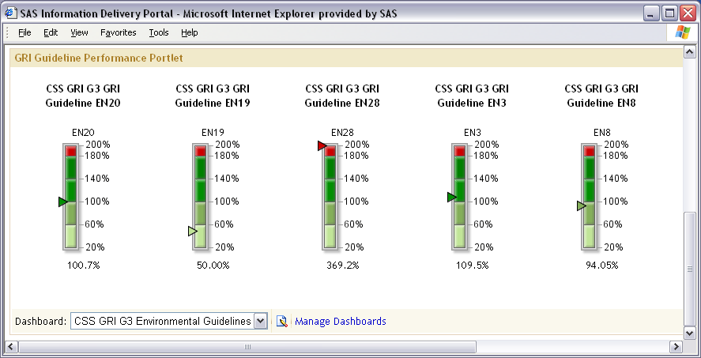
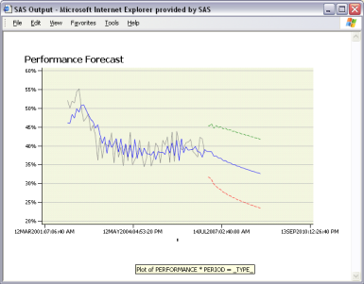
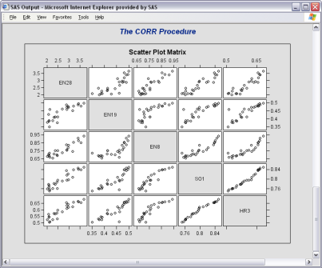
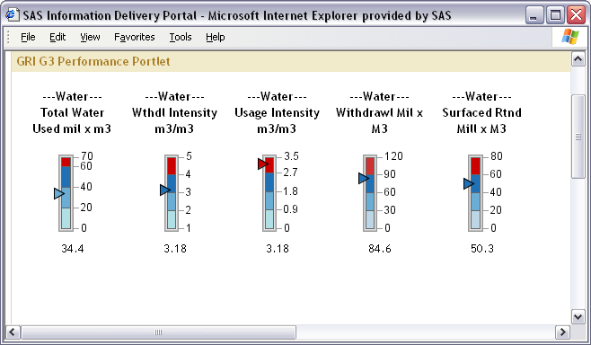
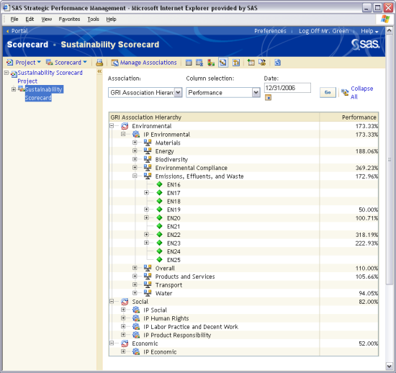
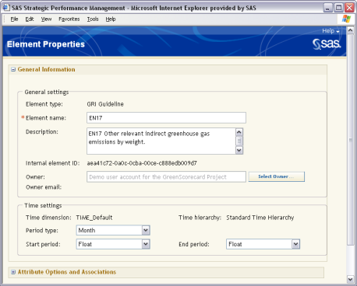
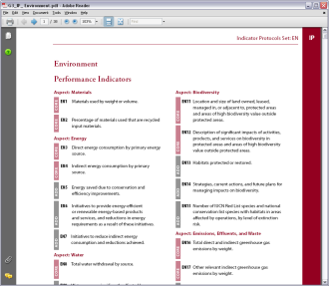
Performance Management Framework
Pre-Built SAS® BI Dashboards
Integrated SAS® Analytics
SAS® Performance Management Scorecard Template
(GRI G3 or IPIECA)
Notes:
*AE* look up your prospect’s Corporate Social Responsibility report (either on their website or in www.corporateregister.com) and see if they comply with GRI standards*
We used the Global Reporting Initiative (GRI) as our first framework because it was the most widely accepted in the industry and because it spans all three pillars of sustainability – environmental, social, and economic.
For Oil & Gas, we also support the IPIECA standard (seen on next slide).
We then built analytic routines such as correlations across KPIs and some forecasting to provide insight into what performance indicators are related to each other and what will our future performance be if we leave business as usual.
Executives can quickly see performance to target through dashboards. Analysts can use embedded BI capability to surface current reports.
15

Slide 16
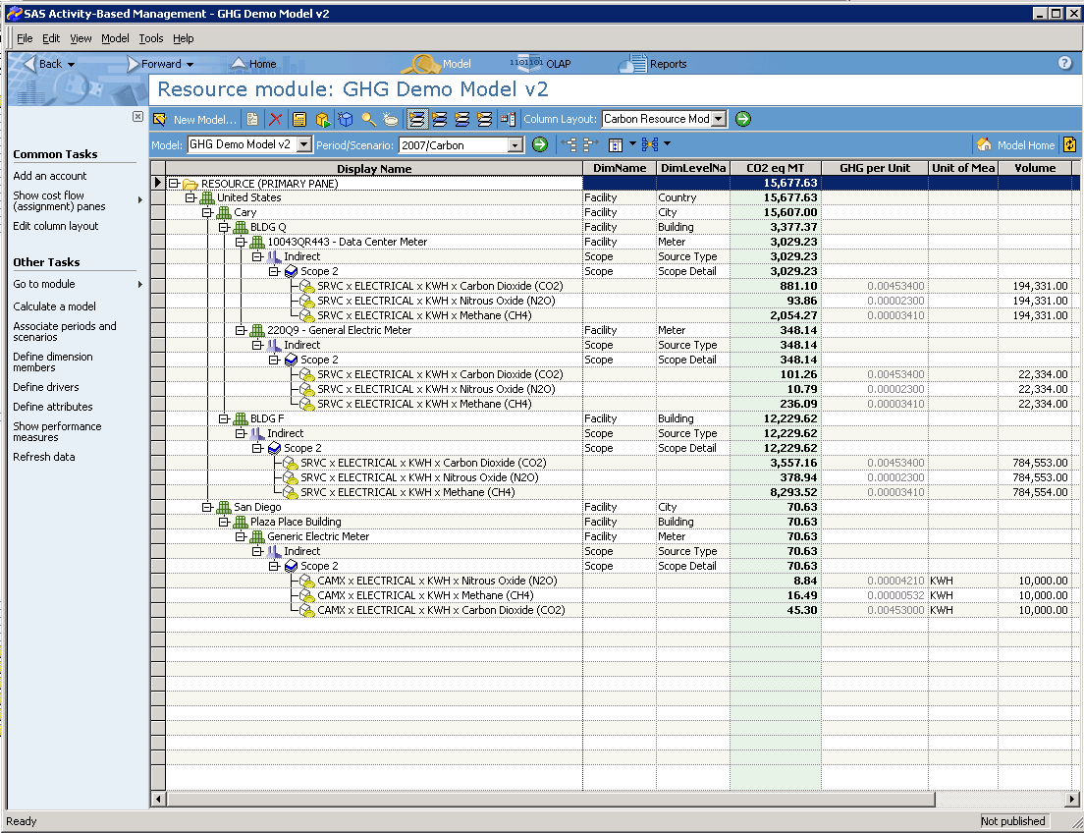
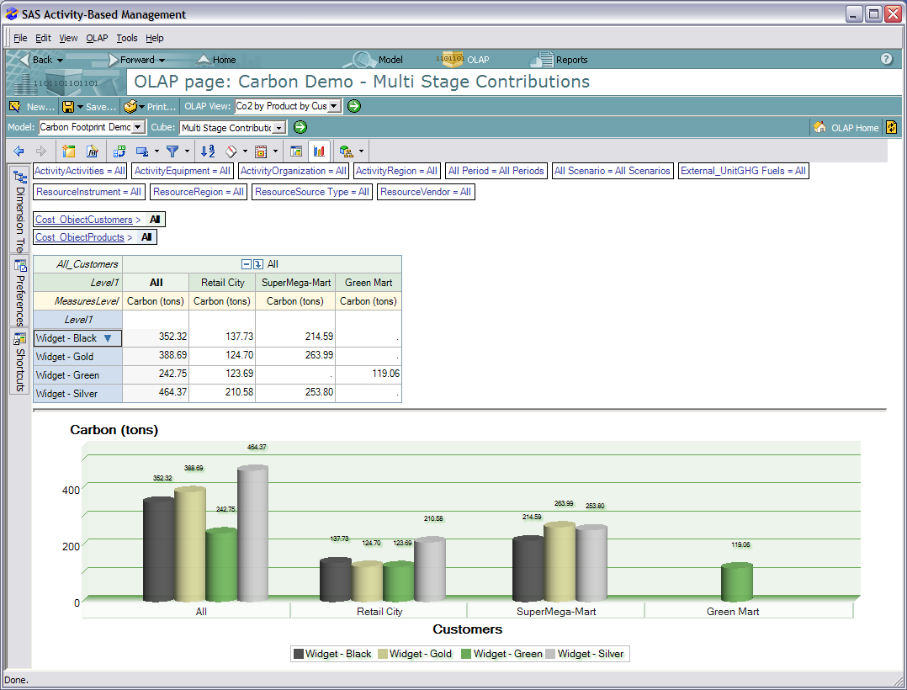
Activity-Based Carbon Footprint Modeling
Notes:
Carbon footprint modeling begins with an assessment of current greenhouse gas emissions. We have applied the Scope 1 and Scope 2 frameworks from the Greenhouse Gas Protocol (www.ghgprotocol.org).
In addition, we have pre-built the eGrid and International Energy Agency carbon emissions variables for electricity purchased off any grid in the world.
Customers must customize the data model to match their facilities and products. In addition, customers must provide attributes by which they want to later analyze the greenhouse gas emissions (square footage, headcount, etc.)
Once the current assessment is complete, the organization can conduct “what if” scenario modeling by taking a duplicate instance of the current model and making changes that are consistent with the model being tested. This will produce a different greenhouse gas emissions value than the current model. The alternate scenario can also be forecasted to see what the impact of that scenario will be in future years. This is particularly important if there is a significant financial investment required for the realization of the scenario.

Slide 17
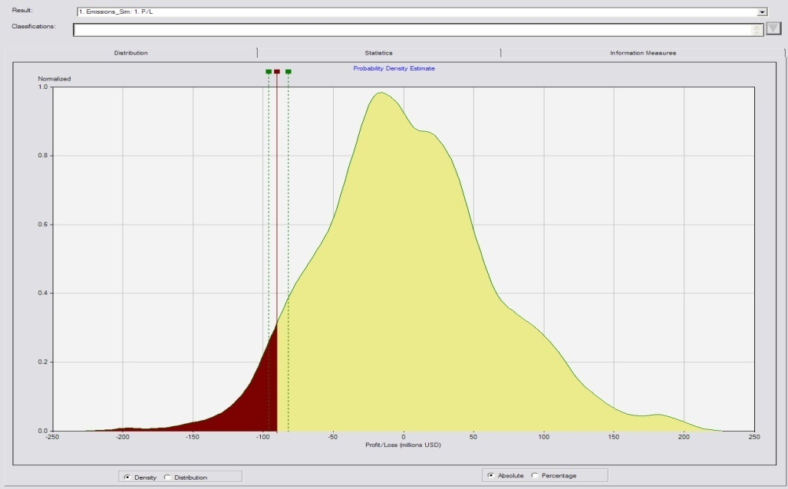
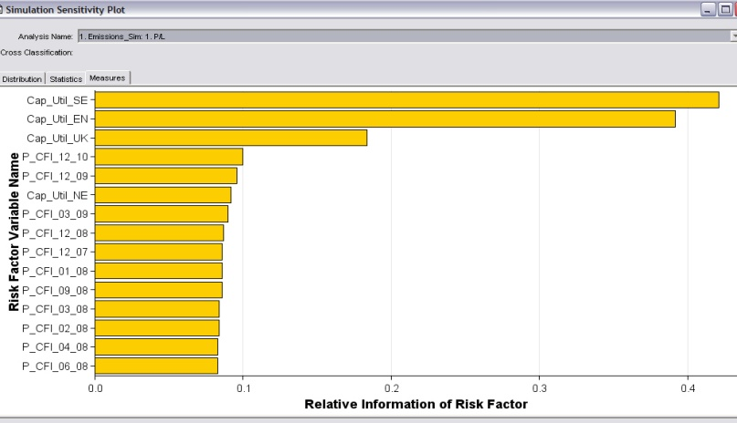
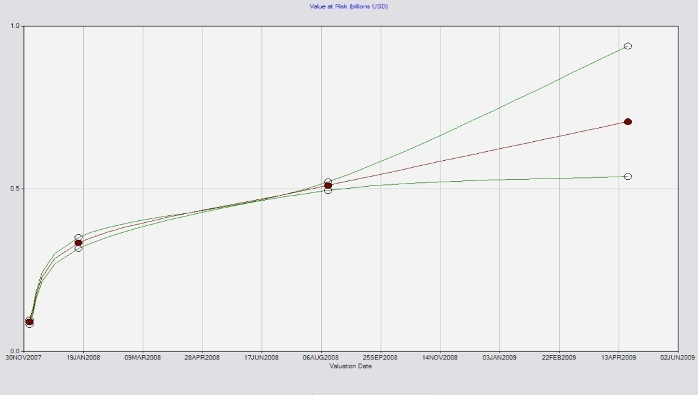
Carbon Cap-and-Trade Risk Management
Notes:
The graphic in the top right is a plot of a probability density estimate and we are most concerned with the red area that makes up the left side of the distribution. This is a statistical probability calculation of the Value at Risk (VaR) of carbon. A VaR statistic answers the question, "What is my worst-case scenario?" or "How much could I lose in a really bad month?"
A VAR statistic has three components: a time period, a confidence level and a loss amount (or loss percentage).
The "VAR question" has three elements: a relatively high level of confidence (typically either 95% or 99%), a time period (a day, a month or a year) and an estimate of investment loss (expressed either in dollar or percentage terms).
The remaining graphics get to the heart of the carbon market simulation. These risk statistics provide energy or carbon analysts with information about how your Co2 rates are fluctuating over time and the amount of allowances you may have to purchase to offset those increases.
Also, looking at this over time we can see that as we look into the future, the underlying volatility widens our confidence intervals.

Slide 18
3
Beneficios para el negocio
Notes:
18

Slide 19

Beneficios de Implementar una Estrategia de Sustentabilidad
Atraer nuevos clientes
Retener clientes actuales
Reducir riesgos
Reducir costos operativos
Mejorar el cumplimiento de las regulaciones
Aprovechar las ventajas de mercado de bonos de carbono
Replantear las prioridades de inversión
Notes:
To summarize the outcomes anticipated, organizations are adopting sustainability programs to:
(note each bullet)
These all have bottom line benefit. And that’s why the theme of our event today has been focused on maximizing impact even in challenging economic times. There is a business case for sustainable innovation.

Slide 20
4
Casos de Exito
Notes:
20

Slide 21

SAS® Gestión de Sustentabilidad para la Industria de la Manufactura
Ahorro de Energía
  Cemig, Dominion, AstraZeneca, Shangia Baosteel, Posco
Reducción de Desperdicios
  W.L. Gore, Robert Bosch, Waitrose, Altis, IBM
Optimización de Transporte
  Illinois DOT, Jet Services, Bunge, American West Airlines
21
Notes:
21
SAS has worked in the past with many customers to improve their energy consumption, reduce waste and optimize transportation.
SAS has a culture of innovation – SAS spend 24% of its revenue in R&D – and collaboration with its customers.
That’s why SAS solution respond to our customer’s needs and developing solutions asked for by our customers is SAS’s most effective marketing strategy.

Slide 22



Optimización de Red de Transporte
Bunge Alimentos
28 plantas
200 silos
8 puertos
8 sitios de transferencia
Costo de Transporte > 700 MDDS
Optimización de Mediso de transporte:
Camión
Tren y
Barcos
RR
AP
Itacoatiara
Sao Luis
AM
PA
CE
MA
PI
RN
PB
PE
AC
RO
TO
BA
SE
AL
MT
Ilhéus
ALMACEN
GO
PUERTO
MG
TRANSFERENCIA
MS
ES
Vitória
FABRICA
SP
RJ
Santos
PR
Paranaguá
SC
São Francisco do Sul
RS
(Source: http://www.sas.com/news/preleases/041707/news6BungeOR.html)
Rio Grande
Notes:
Bunge is the largest fertiliser and agribusiness in Brazil.
Bunge collects agricultural products like soybean and wheat from farmers, brings it to Bunge 28 plants and exports goods over 8 ports. The inbound and outbound distribution network contains 200 silo’s.
All transport between all these distribution centers is optimised by SAS. SAS determines not only the shortest routes and location of distribution centers but selects also the most economical way of transport by air, train or road.
This saves Bunge a lot of money if you know that Bunge pays yearly 700 mio$ on freight costs.

Slide 23
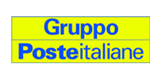
Optimización de Consumo de Energia
RETO:
Lograr los objetivos de eficiencia de energía en al menos 250 instalaciones de Poste Italiane Group, incluyendo aquellas con el más alto consumo de energía – tales como centros de procesamiento de datos, pficinas ejecutivas y grandes sucursales.
Solución:
Con SAS gestión de Sustentatbilidad, Poste Italiane Group analiza la demanda de servicios y provee información sobre el comportamiento de consumo energético de usuarios involucrando modificaciónes a los programas de mantenimiento de sistemas e instalaciones.
Beneficios:
Los resultados en el corto plazo incluyen una reducción del 1% anual en consumo y 7% de reducción emisiones de CO².

